Slide 1
A presentation to the Governing Body
by Christine Turner (2015)

Slide 2
Project Origins

Slide 3
www.digilitleic.com

Slide 4
Open Educational Resources (OER)

Slide 6
Open Licences

Slide 8
“Open licences, including the Creative Commons licences, provide educators and everyone else with a clear, simple way to specify how resources can be used and reused, and how the work should be credited.”
OER Guidance for Schools

Slide 9
“OER provide a basis for learning resources to be produced jointly, between educators, and also between students. Collaborative learning and the co-construction of knowledge and educational resources are valuable educational approaches.
The process of collaboratively working and creating resources is an important part of learning, and openly licensed resources make it possible for communities and individuals to collaborate with and develop work created by other communities and individuals.”
OER Guidance for Schools

Slide 10
Benefits of OER and Open Licences

Slide 11
Helps reduce costs, and get the most out of existing budgets
Schools can connect to OER networks of educators and expertise
Schools can collaborate and share flexible learning materials
Enables schools to work together
Promotes the outstanding work that staff and schools are doing
Brings educators together and supports school staff in achieving shared goals
Helps develop school communities
Invigorates teaching and can increase quality

Slide 12
Increases the pool of resources available for activities in the classroom
Supports differentiation more easily,
Increases the variety of classroom activities
Helps to provide extension tasks
Increases the availability of free-to-access resources and supplementary materials available to learners
Supports independent learning, providing educationally focused materials in areas young people are interested in learning more about, which might not be covered by the school curriculum
Makes resources available to learners globally

Slide 13
UNESCO (2012)

Slide 14
Permission and Policy

Slide 16
Leicester City Council has given permission for staff at community & voluntary controlled schools in the city to openly license the educational resources they produce in the line of their employment.
What about voluntary aided schools and academies?
The Governing Body is the legal and beneficial owner of the copyright of materials produced by an employee in the line of their employment.
The Governing Body retains copyright ownership of works produced, unless a specific agreement has been made.
Materials produced outside of work that are not organised or paid for by the Governing Body, and completed in the employee’s own time, belong to the employee.

Slide 17
What about voluntary aided schools and academies?
Students own the copyright of materials they produce.
Legally, unless an agreement is already in place, staff should obtain permission from the Governing Body to apply any additional permissions to their work, or to share work on web-based resource sites.
Staff do not have an automatic right to take copies of their work from one employer to another.
Putting agreements in place to openly license work makes sharing and accessing resources simpler.

Slide 18
Creative Commons Licences

Slide 19
Creative Commons Attribution 4.0 International (CC BY 4.0)

Slide 21
Recommendations
“Both the European Commission and UK Government guidelines on the use and reuse of public sector information recommend that licences which place as few restrictions on reuse as possible (while providing acknowledgement) should be used to share publicly funded resources.
In line with these guidelines, we are using and recommending the Creative Commons Attribution licence.”
OER Guidance For Schools

Slide 22
Further Information

Slide 23
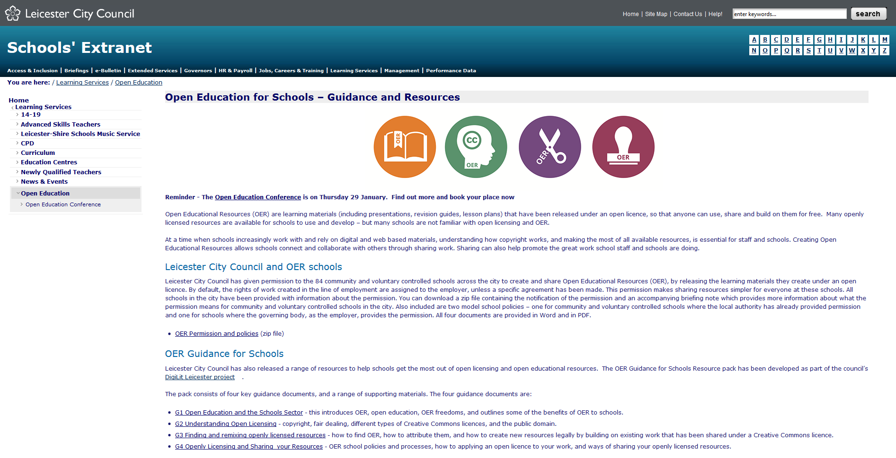
http://schools.leicester.gov.uk/ls/open-education/

Slide 24
Clarity of Licensing
Presentation to Governors (2015) by Christine Turner English Martyrs’ Catholic School shared under a CC-BY 4.0 licence.
Adapted from: Open Schools Governors Briefing (2015) by Josie Fraser/Leicester City Council shared under CC-BY 4.0

