Slide 2
Outcomes After Teaching
The Results

Slide 3
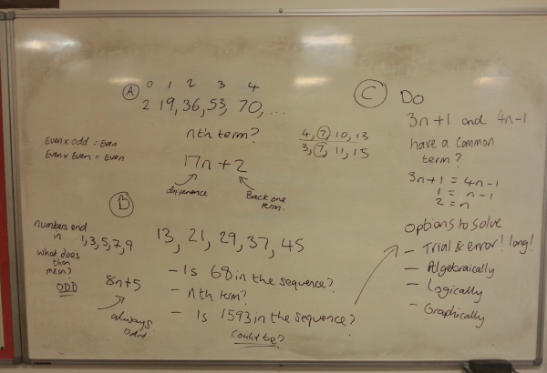

Slide 4
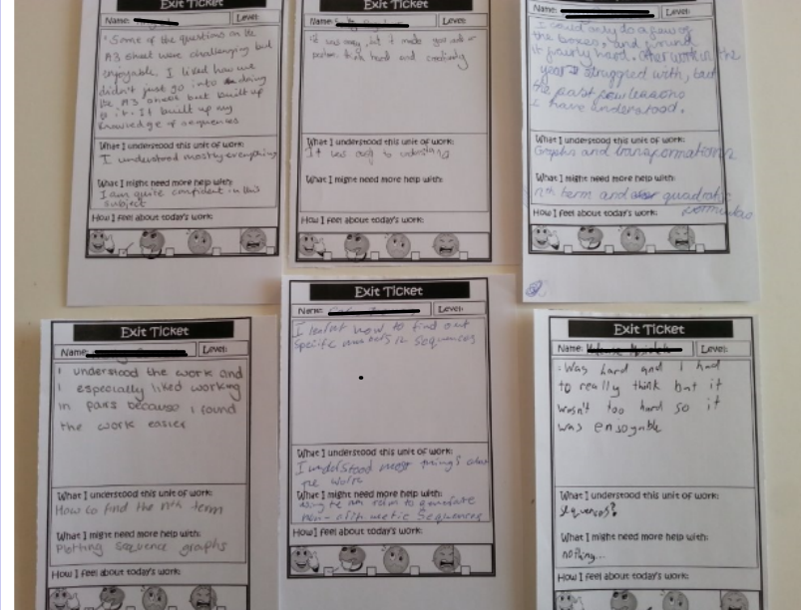
Student Feedback

Slide 5
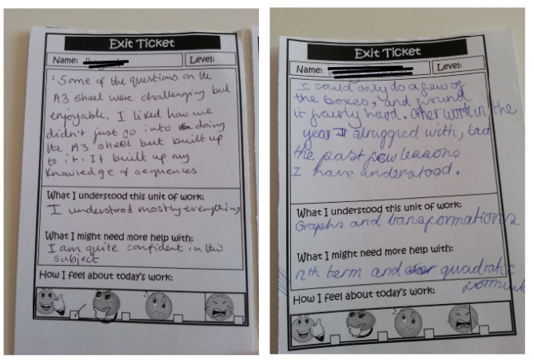

Slide 6
Teaching nth Term

Slide 7
Starter : Youtube Video – Can you solve this?
https://www.youtube.com/watch?v=vKA4w2O61Xo

Slide 10
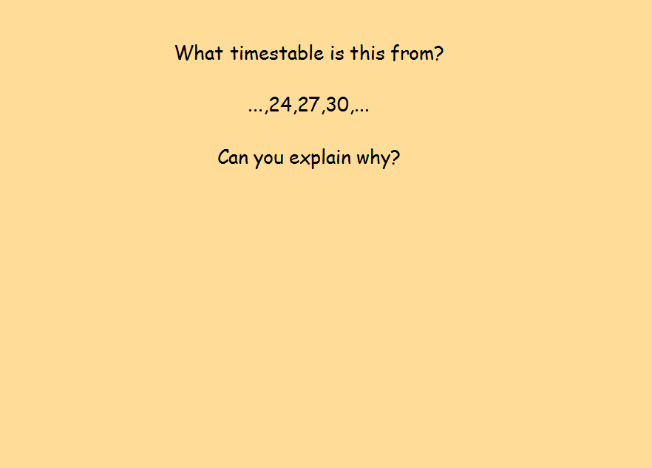

Slide 13
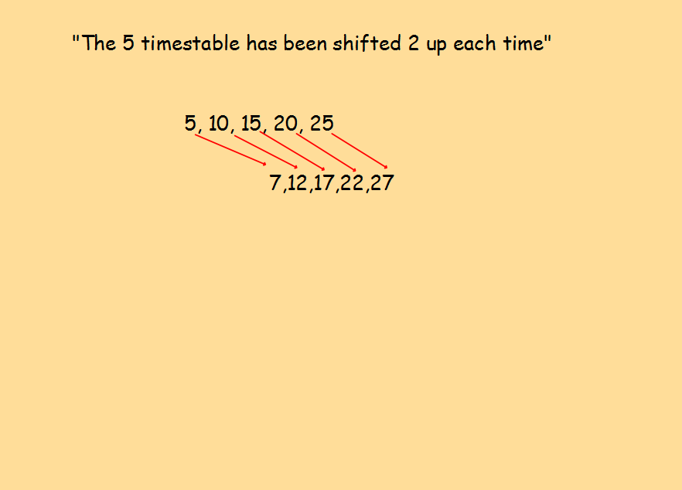

Slide 14
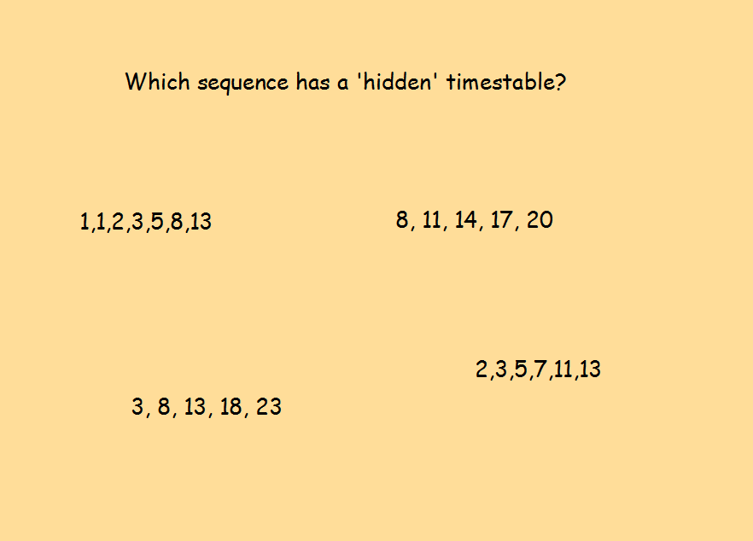

Slide 16
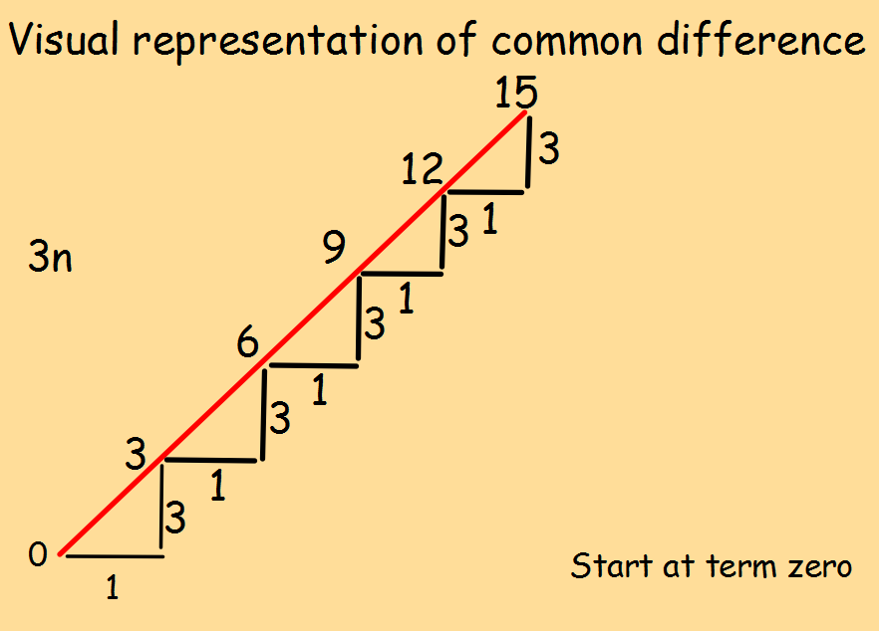

Slide 17
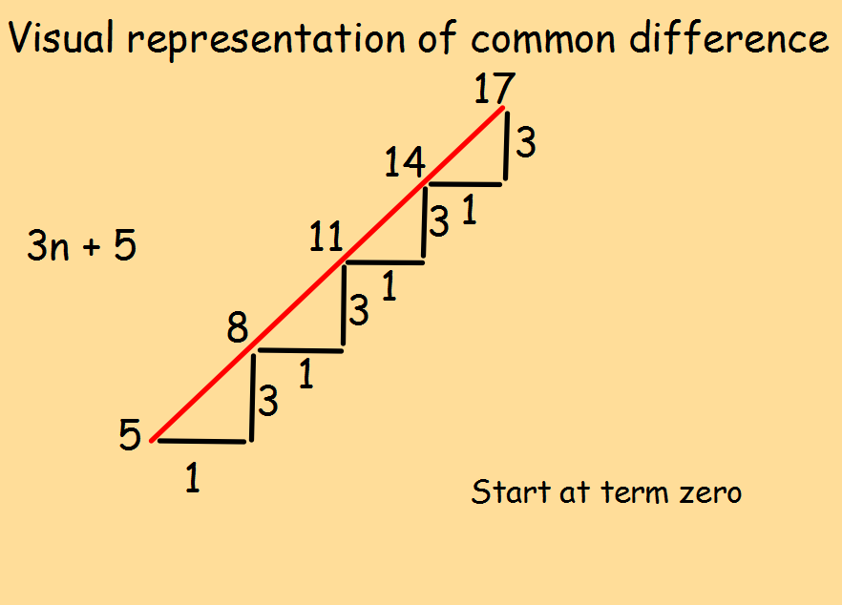

Slide 18
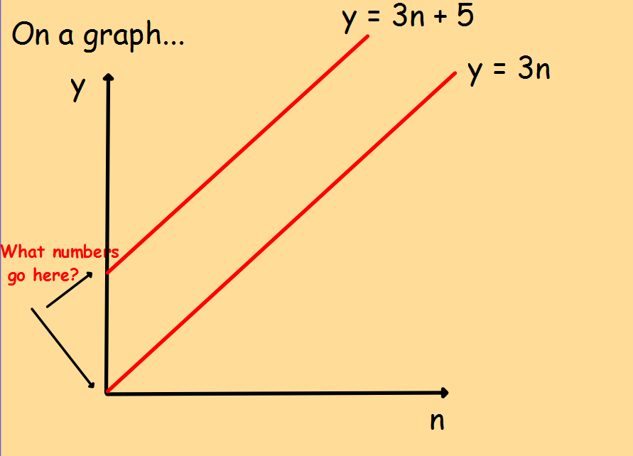

Slide 20
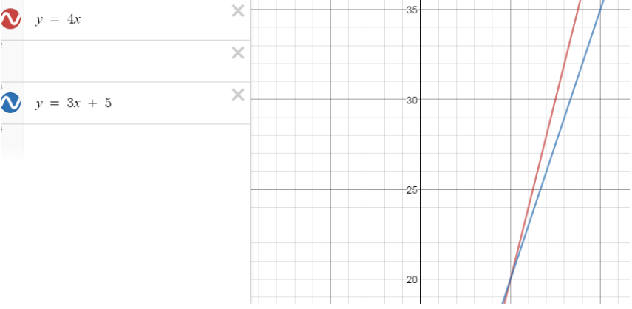
Graphically

Slide 21
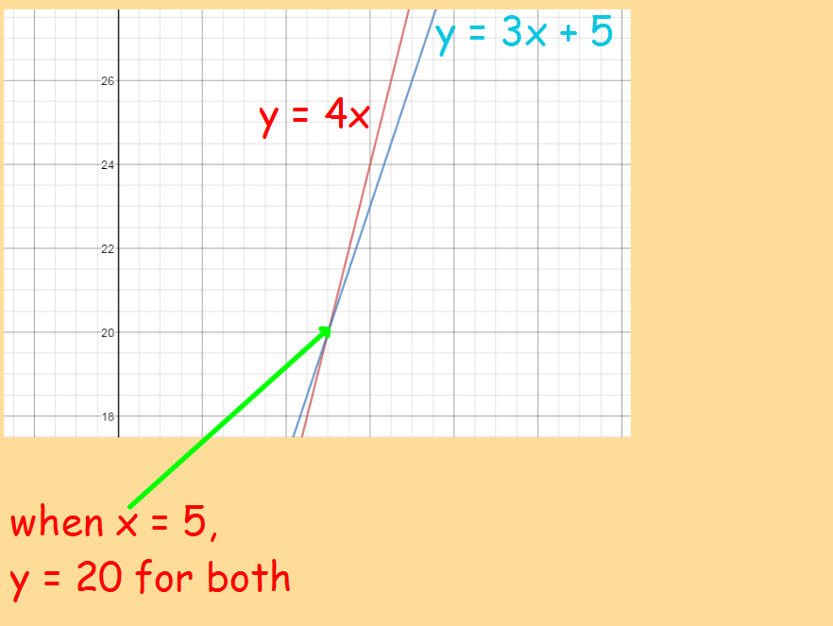

Slide 22
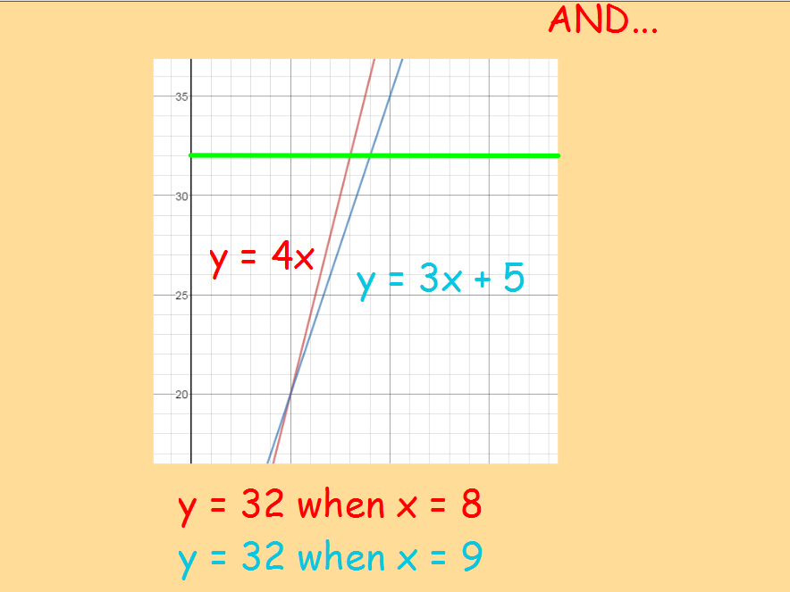

Slide 24
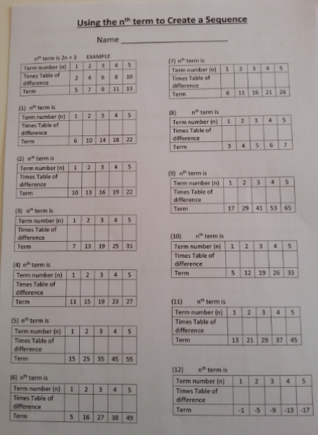

Slide 33
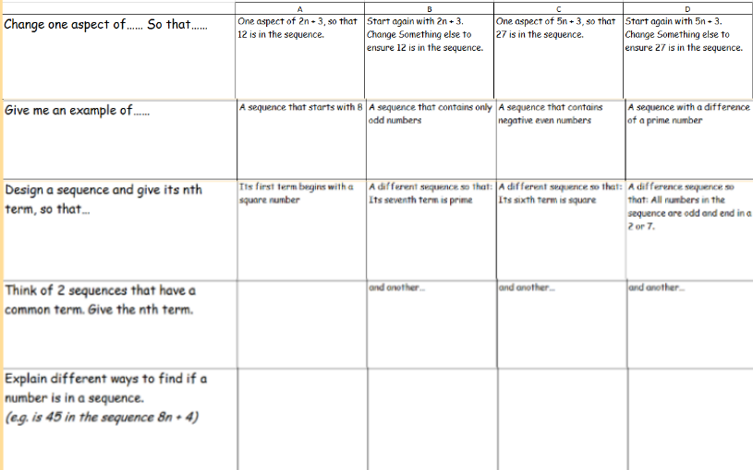

Slide 34
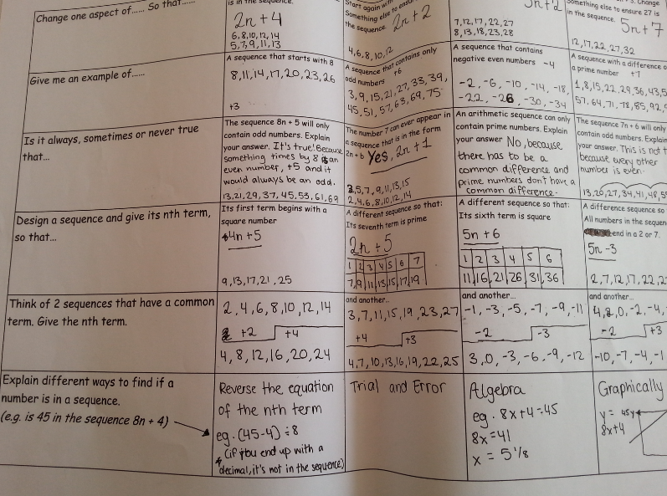

Slide 35
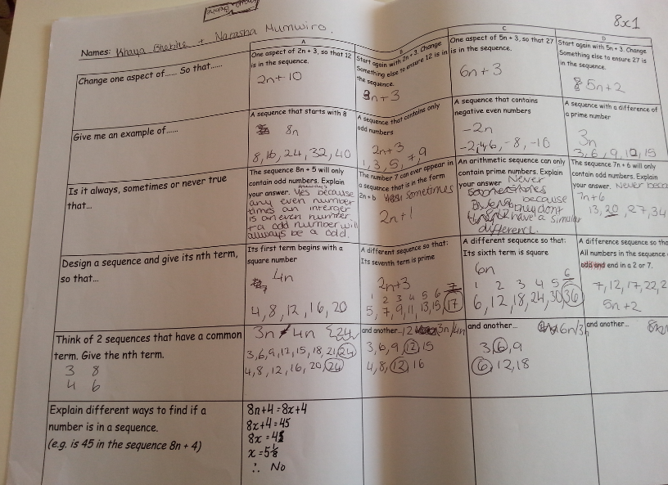

Slide 36
Nth term – a shift in a times table, by Richard Handley (2017), English Martyrs Catholic School .This work is licensed under a Creative Commons Attribution 4.0 International License.

