Slide 1
Intellectual Property Rights, Creative Commons Licenses and OERs
Christine Turner
English Martyrs’ Catholic School, Leicester

Slide 2
Is this your Intellectual Property?
I made the resource during school time on my own device.
I made the resource at home, using my school laptop.
I made the resource at home, on my own device, but I can use it in my lessons/role.
I made the resource at home, on my own device, and it’s not something I could really use in my lessons/role.

Slide 3
Is this your Intellectual Property?
For teachers and other adults working in this school, copyright arising from the work we do is owned by the Governing Body.
The definition of what is “work for school” is defined by the terms of the conditions of employment rather than by criteria such whether it was created in-school or at home; whether it was done in school time or in evenings or holidays.
The UK IP Office describes the situation: “Where a written, theatrical, musical or artistic work, or a film, is made by an employee in the course of his employment, his employer is the first owner of any copyright in the work (subject to any agreement to the contrary).”

Slide 4
Copyright Law and Creative Commons
Copyright law gives creators certain kinds of control over their creative work.
If people want to use copyrighted work, they often have to ask for permission from the creator.
Creative Commons works within copyright law.
It allows creators to grant permission to everyone in the world to use their work in certain ways.

Slide 5
New Open Educational Resource Policy
This will be placed in pigeon holes – please read it!
The governing body has given permission for staff at English Martyrs’ School to openly license the educational resources they produce in the line of their employment under a Creative Commons license.
Openly sharing high quality educational resources helps other educators and learners benefit from, and build upon, the work our staff are doing.
It supports collaboration between staff in the city and beyond.
Putting agreements in place to openly license work makes sharing and accessing resources simpler for everyone, and provides additional opportunities for schools and school staff.

Slide 6
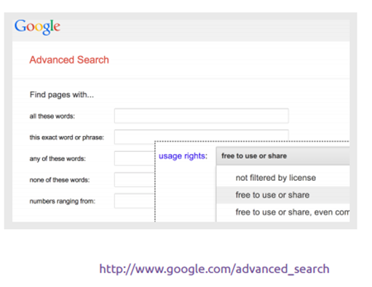
Finding Open Educational Resources
The Creative Commons logo shows that more flexible permissions have been provided to use and reuse content.
The public domain logo indicates that resources are free from restrictions.
You can find Creative Commons licensed content using special search functions of search engines and websites e.g. Google has an ‘advanced search’ that lets you search by ‘usage rights’ for content shared under an open licence:

Slide 7
Creative Commons Licenses
Creative Commons licenses are made up of four conditions that can be mixed and matched to create six different license combinations.

Slide 8
How to choose the right license
Do you want to allow adaptations of your work to be shared?
Yes
The license permits others to copy, distribute, display, and perform the work, as well as make and distribute derivative works based on it.
Yes, as long as others share alike
The license permits others to create and distribute derivative works, but only under the same or a compatible license.
No
The license permits others to copy, distribute, display, and perform the work, but not distribute derivative works based on it.

Slide 9
How to choose the right license
Do you want to allow commercial uses of your work?
Yes
The license permits others to copy, distribute, display, and perform the work, including for commercial purposes.
No
The license permits others to copy, distribute, display, and perform the work for non-commercial purposes only.

Slide 10
Task
Here is a quick exercise to test your understanding of CC licenses.
Below are a few different kinds of icons that all mark works with different CC licenses.
For each one, explain in a sentence or two what you can and cannot do with works that someone has shared under that license.

Slide 11
Answers
One can use the resource, but must give the creator credit and must not change, alter or remix the resource. The user can benefit commercially from the resource.
One can use the resource, but must give the creator credit and must not benefit commercially from the resource. The user may alter the resource, but this new altered version must have the same licenses as the original.
One can use the resource, but must give the creator credit. The user may alter the resource, benefit commercially from its distribution, and make the new resource with whatever licenses the user chooses.

Slide 12
Discussion Task
You are a relatively obscure musician who wants as many people to discover your music as possible, but also wants to be able to reserve the commercial right to sell your work. Which license(s) might you choose?
You are a secondary school teacher who has created a great resource on how the solar system works, and want other teachers to benefit. Which license(s) would you choose?
You are an amateur photographer who has taken photos of landmarks in your area and want them to be featured in their Wikipedia articles. Which license(s) do you choose?

Slide 13
Twitter
Websites and Blogs
http://digilittleacorns.weebly.com/digilit-blog
www.oerschools.com
@digilittleacorn
#digilittleacorns

Slide 14
Useful Resources
Information regarding IPR, Copyright Law and Teaching:
http://creativecommons.org
https://www.gov.uk/government/uploads/system/uploads/attachment_data/file/375951/Education_and_Teaching.pdf
http://www.copyrightsandwrongs.nen.gov.uk/schools-a-copyright/teacher-the-workforce-the-school-and-copyright
https://www.jisc.ac.uk/guides/intellectual-property-rights-in-a-digital-world

Slide 15
Acknowledgement
Intellectual Property Rights, Creative Commons Licenses and OERs (2015), by C Turner, English Martyrs’ Catholic School, Leicester, available under a Creative Commons Attribution 4.0 International license (CC-BY-4.0)
This document builds upon and adapts the works of:
Finding and Attributing Openly Licensed Resources : Guidance and Training for School Admin Teams (2015), by N Ward, St. Paul’s Catholic School, Leicester, available under a Creative Commons Attribution 4.0 International license (CC-BY-4.0), and
OER Guidance for Schools (2014), by Björn Haßler, Helen Neo and Josie Fraser. Published by Leicester City Council, available under a Creative Commons Attribution 4.0 International license(CC-BY-4.0)

