Slide 1
Concentration of solutions
C3.7
Foundation Tier

Slide 2
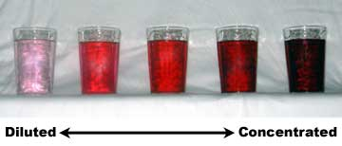
What do we mean by concentration?
It is a measure of how much solute (solid) is dissolved in a solution.
A dilute solution only has a little dissolved
A concentrated solution has a lot
Notes:
Image checked for license

Slide 3
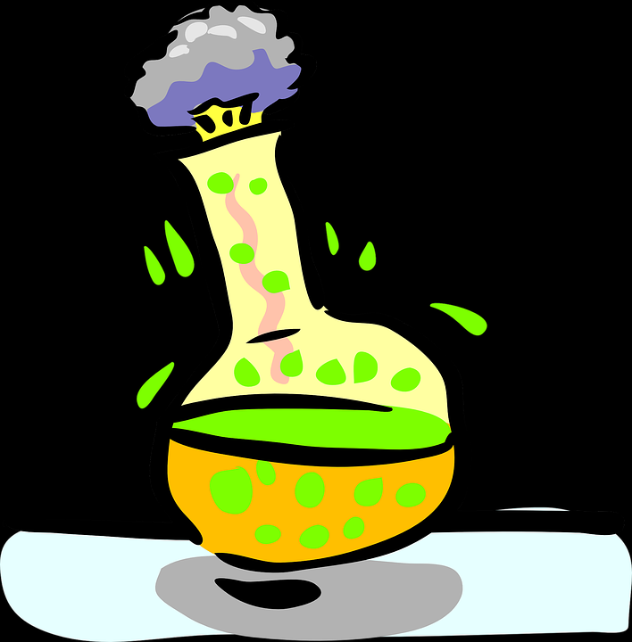
Concentration
Many chemical reactions take place in solution.
The concentration of a solution can be measured in mass per dm³
1 dm = 1 cm
1 dm³ = 1 litre
Notes:
Image checked for license

Slide 4
Concentration
If 10g of salt is dissolved in 1 dm³,
the concentration will be: 10 ÷ 1
= 10g/dm³
The equation is:
Conc = mass /volume
Notes:
Image checked for license

Slide 5
Your turn
Attempt the questions of p12 of the booklet

Slide 6
Guess What…
We can also calculate concentration using …
moles.
Concentration (in mol/dm³) = no. of moles
volume

Slide 7
Concentration
5.85g of sodium chloride is dissolved in 0.5 dm³,
Mr of NaCl
= 23 + 35.5
= 58.5
The no. of moles
= 5.85 / 58.5 =0.1 mol
Notes:
Image checked for license

Slide 8
Concentration
5.85g of sodium chloride is dissolved in 0.5 dm³,
Conc = no. of moles volume
= 0.1 / 0.5
= 0.2 mol/dm³
Notes:
Image checked for license

Slide 9
Converting between g/dm³ and mol/dm³
÷ Mr
g/dm³
mol/dm³
x Mr

Slide 10
Converting between cm³ and dm³
÷ 1000
cm³
dm³
x 1000

Slide 11
Questions
1 A bottle of hydrochloric acid has a concentration of 0.5 mol dm^{–3}. What is its concentration in g dm^{–3}?
2 A solution of hydrogen peroxide (H₂O₂) has a concentration of 1.7 g dm^{–3}. Convert this concentration into mol dm^{–3}.
Conversion factors:
1 dm³ = 1000 cm³ = 1000 ml = 1 litre

Slide 12
Now…
Attempt the questions on pages 13&14

Slide 13
Summary
There are two ways of giving a value for concentration:
g dm⁻³ – mass of solute per dm³
mol dm⁻³ – moles of solute per dm³

Slide 14
So…
g dm⁻³
Conc = mass
volume
1. What is the conc in g dm⁻³ of 0.5dm³ solution that contains 10g of NaOH?
Mol dm⁻³
Conc =no. of moles
volume
2. What is the conc in mol dm⁻³ of 0.5dm³ solution that contains 10g of NaOH?

Slide 15
Syllabus
4.3.2.5 Concentration of solutions
Many chemical reactions take place in solutions. The concentration of a solution can be measured in mass per given volume of solution, eg grams per dm3 (g/dm3).
Students should be able to:
• calculate the mass of solute in a given volume of solution of known concentration in terms of mass per given volume of solution
• (HT only) explain how the mass of a solute and the volume of a solution is related to the concentration of the solution.
4.3.4 Using concentrations of solutions in mol/dm³ (chemistry only) (HT only)
The concentration of a solution can be measured in mol/dm3.
The amount in moles of solute or the mass in grams of solute in a given volume of solution can be calculated from its concentration in mol/dm3 .
If the volumes of two solutions that react completely are known and the concentration of one solution is known, the concentration of the other solution can be calculated.
Students should be able to explain how the concentration of a solution in mol/dm3 is related to the mass of the solute and the volume of the solution. Opportunities within titrations including to determine concentrations of strong acids and alkalis.

Slide 16
C3.7 Conc of solutions - HT (2017) by Ian Sadler (English Martyrs’ Catholic School) shared under a Creative Commons Attribution 4.0 International License.

