Slide 1
Concentration of solutions
C3.7
Foundation Tier

Slide 2
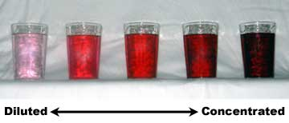
What do we mean by concentration?
It is a measure of how much solute (solid) is dissolved in a solution.
A dilute solution only has a little dissolved
A concentrated solution has a lot
Notes:
Image checked for license

Slide 3
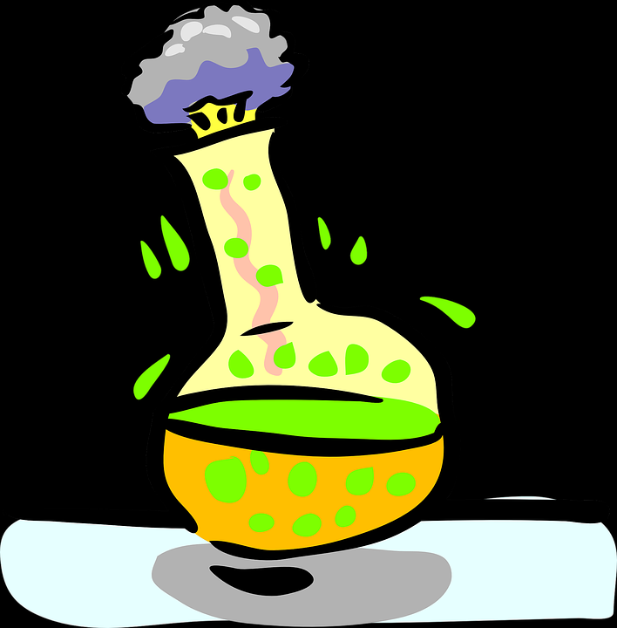
Concentration
Many chemical reactions take place in solution.
The concentration of a solution can be measured in mass per dm³
1 dm = 10 cm
1 dm³ = 1 litre
Notes:
Image checked for license

Slide 4
Concentration
If 10g of salt is dissolved in 1 dm³,
the concentration will be: 10 ÷ 1
= 10g/dm³
The equation is:
Conc = mass /volume
Notes:
Image checked for license

Slide 5
Your turn
Attempt the questions of p7?? Of the booklet

Slide 6
Syllabus
4.3.2.5 Concentration of solutions
Many chemical reactions take place in solutions. The concentration of a solution can be measured in mass per given volume of solution, eg grams per dm3 (g/dm3).
Students should be able to:
• calculate the mass of solute in a given volume of solution of known concentration in terms of mass per given volume of solution
• (HT only) explain how the mass of a solute and the volume of a solution is related to the concentration of the solution.
4.3.4 Using concentrations of solutions in mol/dm³ (chemistry only) (HT only)
The concentration of a solution can be measured in mol/dm3.
The amount in moles of solute or the mass in grams of solute in a given volume of solution can be calculated from its concentration in mol/dm3 .
If the volumes of two solutions that react completely are known and the concentration of one solution is known, the concentration of the other solution can be calculated.
Students should be able to explain how the concentration of a solution in mol/dm3 is related to the mass of the solute and the volume of the solution. Opportunities within titrations including to determine concentrations of strong acids and alkalis.

Slide 7
C3.7 Conc of solutions – FT (2017) by Ian Sadler (English Martyrs’ Catholic School) shared under a Creative Commons Attribution 4.0 International License.

