Slide 1
Mass Changes and Uncertainty
C3.4

Slide 2
Demonstration 1
SAFETY: do not stare at burning magnesium, wear goggles
Record the mass of the magnesium ribbon on p8
Zero the balance with the tin lid on, remove the lid to the heat proof mat.
Light magnesium ribbon over a Bunsen burner holding the burning magnesium over a tin lid so that any ash falls in.
When the magnesium stops burning, put any ash in the lid.
Record the mass of the ash on p8.
Calculate the change in mass

Slide 3
Demonstration 2
SAFETY: wear goggles
Put 50ml of HCl acid into a conical flask
Add 3 marble chips (calcium carbonate) and quickly place the cotton wool in the neck of the flask.
Record the mass of the flask
Record the mass after two minutes.
Calculate the change in mass

Slide 4
Demonstration 3
SAFETY: wear goggles
Record the mass of a beaker with the screwed up paper in.
Light the paper and wait for it to go out
Record the mass of the beaker again
Calculate the change in mass

Slide 5
Demonstration 4
SAFETY: wear goggles
Balance a ruler with iron wool at one end and blue tack on the other.
Heat the iron wool strongly
Record your observation on p8 of the booklet

Slide 6
BUT…
What about…
The Conservation of Mass
In all of these demonstrations, the mass changes.
Discuss with other students how the conservation of mass can still be correct.

Slide 7
So…
How can the mass change and the conservation of mass still be true?
Gases can be lost to the air and so their atoms are no longer measured on the balance – in this case the mass decreases
Gases from the air can add to the substances and so their atoms are now measured on the balance – in this case the mass increases

Slide 8
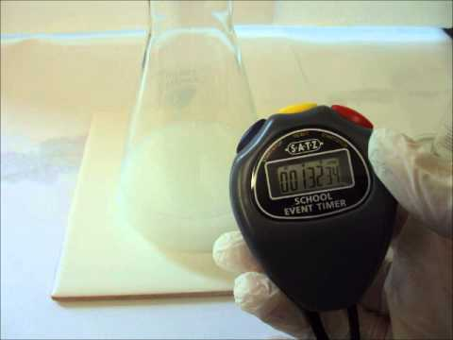
PRACTICAL
When you mix sodium thiosulfate with hydrochloric acid, the mixture becomes cloudy.
If you wanted to time how long it took to go cloudy, when would you decide to stop the stopwatch?

Slide 9
PRACTICAL
Let’s imagine there are three groups:
Group 1 press stop when they think it is cloudy enough.
Group 2 put a cross under the flask and press stop when they can’t see the cross.
Group 3 use a lamp and a light sensor, they press stop when the light level falls below a particular value.
You will be group 2. We will compare your results to the other groups.

Slide 10
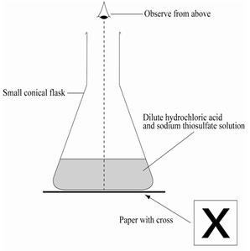
Instructions
Put on your goggles
Put 10cm³ of sodium thiosulfate in the conical flask
Add 10cm³ of hydrochloric acid and start the stopwatch
Place the flask on the cross
When the cross can no longer be seen, stop the stopwatch
Add the time in the middle column of the table on page 8.
Finally, empty the flask into the waste tub provided
Repeat the experiment 3 times

Slide 11
Uncertainty
Look at the three groups results:
Which are the most uncertain?
How can you tell?
Do any of these methods have no uncertainty?
Group 1
These have the greatest variation in results
All experimental methods have some uncertainty

Slide 12
How can we represent uncertainty?
100
75
50
25
0
Group 1
Group 2
Group 3

Slide 13
For Group 1
Find the mean and plot it.
Add the highest and lowest values to the graph
Draw a line to connect the highest and lowest values
100
75
50
25
0
Group 1
Group 2
Group 3

Slide 14
Do this for the other groups results
These are called error bars.
How can they show how uncertain the results are?
100
75
50
25
0
Group 1
Group 2
Group 3

Slide 15
C3.4 Mass change and uncertainty (2017) by Ian Sadler (English Martyrs’ Catholic School) shared under a Creative Commons Attribution 4.0 International License.

