Slide 1
Counting Atoms

Slide 2
Counting Atoms
Sometimes it might be useful to know how many atoms there are in a substance, but…
Why might this be difficult?
Yes, because they are so small.
Even a tiny piece of a substance will have a huge number of atoms in it.

Slide 3
Counting Atoms
For example, how many atoms are there in 1cm³ of water….
approximately….
100000000000000000000000
[that’s 1 x 10²³]

Slide 4
Avogadro
A scientist named Avogadro worked out that they were the same number of particles in the formula mass of any substance.
For example,
18g of water (Mr =18) has the same number of molecules as 64g of sulfur dioxide (Mr=64)
Notes:
Images checked for license – non- commercial

Slide 5
Amount of substance
Chemists use a quantity called amount of substance for counting atoms
Amount of substance is:
Given the symbol, n
Measured in a unit called moles

Slide 6
Avogadro’s constant
Amount of substance is based on a standard count of atoms called the Avogadro’s constant, N_{A}
N_{A} = 6.02 x 10²³ mol⁻¹
This is the number of atoms in one mole.

Slide 7
Moles calculations
You can find the mass of one mole (1 mol) of atoms of any element – it is the relative atomic mass in grams
1 mol of H has a mass of ___
1 mol of C has a mass of ___
1 mol of Pb has a mass of ___

Slide 8
Moles calculations
You can also work in multiples of 1 mol
1.00 mol of C has a mass of ___
2.00 mol of C has a mass of ___
0.50 mol of C has a mass of ___

Slide 9
Moles of anything!
Amount of substance is not restricted to atoms
You can have an amount of molecules, ions or atoms

Slide 10
Calculating mass
Calculate the mass of:
1 mole of NH₃
1 mole of CO
1 mole of C₆H₁₂O₆

Slide 11
Moles calculations
Mass = No. of moles x Formula Mass
m = n x Mr

Slide 12
Calculating no. of moles
Can you rearrange this equation to work out the no. of moles (n)?
m = n x Mr
n = ?
Hint:
Divide both sides by Mr
n = m
Mr

Slide 13
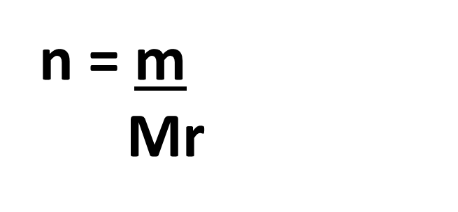
Moles calculations
m = n x Mr
Now work through pages 5 & 6 of the booklet

Slide 14
A video!
https://www.youtube.com/watch?v=TEl4jeETVmg
Notes:
4:43

Slide 15
C3.2 Moles – HT (2017) by Ian Sadler (English Martyrs’ Catholic School) shared under a Creative Commons Attribution 4.0 International License.

